Slide 1

Welcome to HackAI
The Artificial Intelligence Society

Slide 2

About the AIS at UTD
We are a 2 year on-campus organization who aims to educate students about the scientific advancements in artificial intelligence.
Some previous events we’ve hosted:
HackAI’16
Annual Summer AI Conference
Ethics in AI Panel Discussion
Industry Tech Talks (Google, TI)

Slide 3
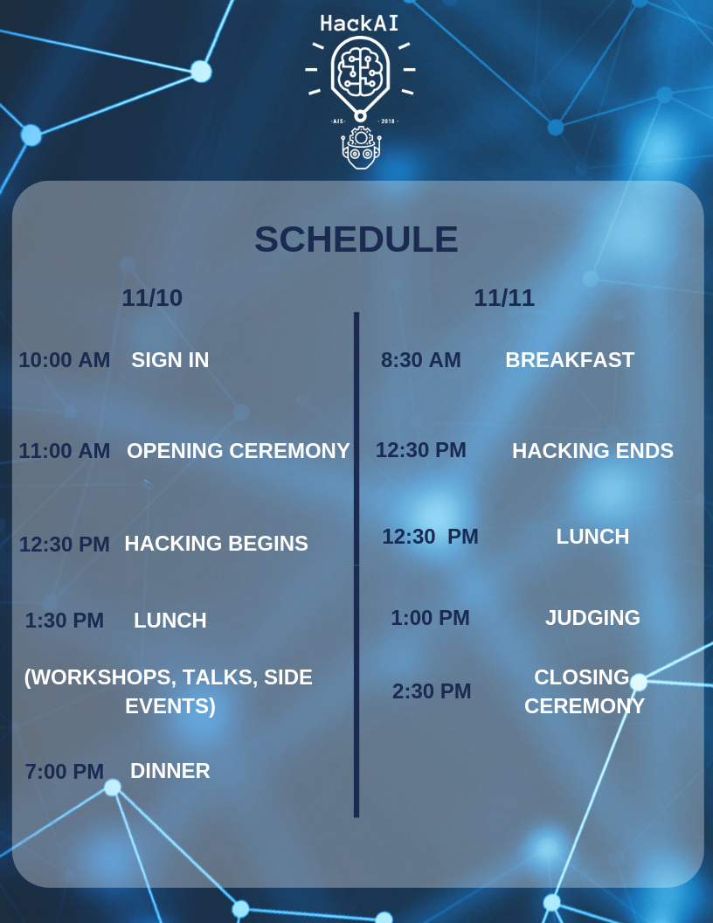
Hackathon Schedule
Notes:
Open to Dr. Gupta’s speech

Slide 4







Big Thanks to Our Sponsors!!

Slide 5
CS. Dept. and Mavericks Challenge

Slide 6
CBRE Challenge

Slide 7




CBRE Build
Information
Session
,
The Future of PropTech
Notes:
Presenter notes:
Introduce yourself (Say name, title, and group)
Mention that the purpose of this presentation is to expose students to a less familiar side of the industry

Slide 8
Agenda
What is PropTech?
Who works on PropTech?
What is the future of PropTech?
What is CBRE Build’s impact?

Slide 9
What is PropTech?
PropTech is short for Property Technology.
It refers to the startups and technologies that
address the inefficiencies and antiquated processes in the real estate industry.
Other names for PropTech include CREtech (Commercial Real Estate Technology) and REtech (Real Estate Technology).

Slide 10
What is the future of PropTech?
Real estate is the largest asset class in the U.S. and there are plenty of opportunities for growth.
Residential Side:
PropTech companies like Zillow are positioning themselves to become online brokers. They use big data and crowdsourced data to assess the value of residential properties.
Commercial Side:
Brokers currently drive the commercial side of the market. However, major players like CBRE Build are shaking things up, using big data, machine learning, and mobile applications to impact key business areas.
Notes:
https://www.tearsheet.co/wtf/wtf-is-proptech
https://www.forbes.com/sites/valleyvoices/2018/02/13/future-of-real-estate-tech/#59c1dcb81c13
https://seekingalpha.com/article/4185187-major-asset-classes-june-2018-performance-review

Slide 11

CBRE
CBRE is the largest commercial real estate services and investment firm in the world. It operates in more than 450 offices worldwide and has clients in more than 100 countries.
Examples of CBRE services include property management, leasing, brokerage services to owners of commercial real estate, and more.
CBRE’s deep heritage and breath of expertise in real estate makes it the prime environment to leverage innovative technologies.

Slide 12
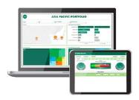
CBRE Build
CBRE Build is the Digital & Tech organization within CBRE.
With offices across the globe, CBRE Build creates innovative technologies that will shape the commercial real estate industry forever.
CBRE Build creates 2D and 3D space visualization tools, uses big data to solve worldwide data problems for customers, develops mobile applications to enhance employee experience in the workplace, etc.

Slide 13
The Challenge
Our theme for the hackathon is that of “Smart Buildings” and the challenge is to hack our way into building potential products, that leverage IOT or AI to help improve CRE attractiveness, measure monetary value OR reduce utility / maintenance costs.

Slide 14
Rules for the Challenge
The problem selected should relate to Commercial Real Estate and have a meaningful use case for the use of one of the 2 below:
IOT
AI

Slide 15
Judgement Criteria
Quality of Idea
1. Creativity
2. Originality
3. Wow Factor
Implementation
1. Choice & Applicability of Technology Stack
2. Solidity of Demo
3. Proximity to End Solution
Potential Impact
1. Measured using KPIs
2. Can this be Productized?
3. Ability to Disrupt

Slide 16
SignaPay Challenge

Slide 17
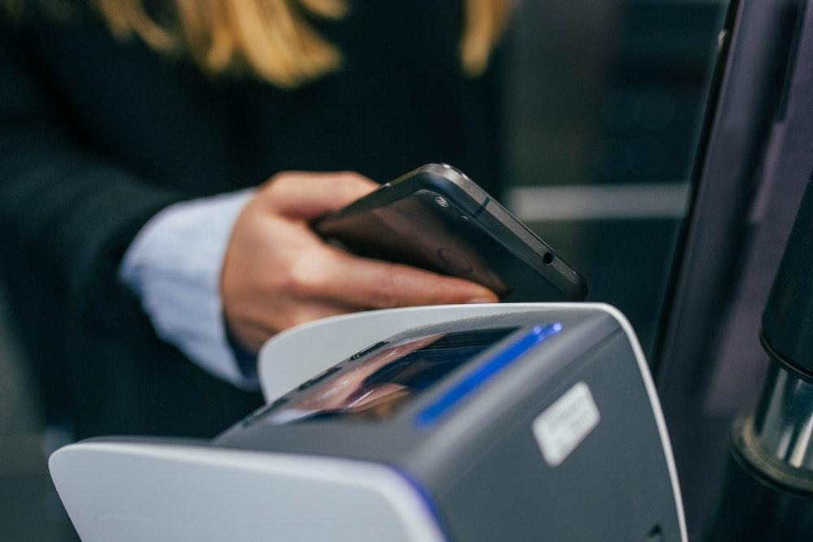
SIGNAPAY
Building Revolutionary AI Powered Payments Platform

Slide 18
HACKATHON CHALLENGE
INPUT WEB FORM
Business Name
Address
URL
Phone
DATA SOURCES – USE PUBLIC APIs
WHOIS ( e.g. only within US allowed )
SOCIAL MEDIA
FINANCIAL
BETTER BUSINESS BUREAU
YELP
REVERSE PHONE LOOKUP OR AUTOMATED CALLING
ANY OTHER PUBLIC SOURCES YOU CAN COME UP WITH, SKY IS THE LIMIT!
OUTPUT
RISK SCORE
EXPLANATION IN LAYMAN ENGLISH ON THE RISK LEVEL OF THE BUSINESS TO BE ACCEPTED FOR CREDIT CARD PROCESSING
VISUAL DESIGN LIKE CHARTS AND GRAPHS RECOMMENDED

Slide 19

EVALUATION CRITERIA
WE WILL INPUT INFO OF 10 REAL BUSINESSES INTO YOUR WEB FORM
PRIZES WILL BE BASED ON
RISK SCORE ACCURACY
CLARITY OF EXPLANATION
DESIGN AND VISUAL PRESENTATION
OUPUT
RISK SCORE
EXPLANATION IN LAYMAN ENGLISH ON WHERE THE RISKS OR WHY IT’S A SAFE BUSINESS TO ACCEPT CREDIT CARDS FROM
VISUAL DESIGN LIKE CHARTS AND GRAPHS RECOMMENDED

Slide 20
DeepCognition Challenge

Slide 21

Deep Cognition
Company Information
Mahesh Kashyap
Chief Digital Officer
mahesh@deepcognition.ai
November 2018

Slide 22
DEEP LEARNING STUDIO AI Development Platform CLOUD | ONPREM
Proprietary and Confidential Copyright 2018

Slide 23




Introducing the Deep Learning Studio (DLS)
The Top Barrier to AI Adoption is Attracting, Acquiring and Developing the Right AI Talent
- MIT Sloan Management Review
Our Platform Greatly Expands the Base of AI Engineers and Makes Them More Efficient
Skills Required Without Platform
Skills Required With Our Platform
Deep Learning Concepts
Python Programming
Deep Learning Concepts
Python Programming
Skills Not Required with Deep Cognition
Data Libraries (OpenCV, Pandas)
DL Frameworks (TensorFlow, Keras, MxNet)
Data Libraries (OpenCV, Pandas)
DL Frameworks (TensorFlow, Keras, MxNet)

Slide 24
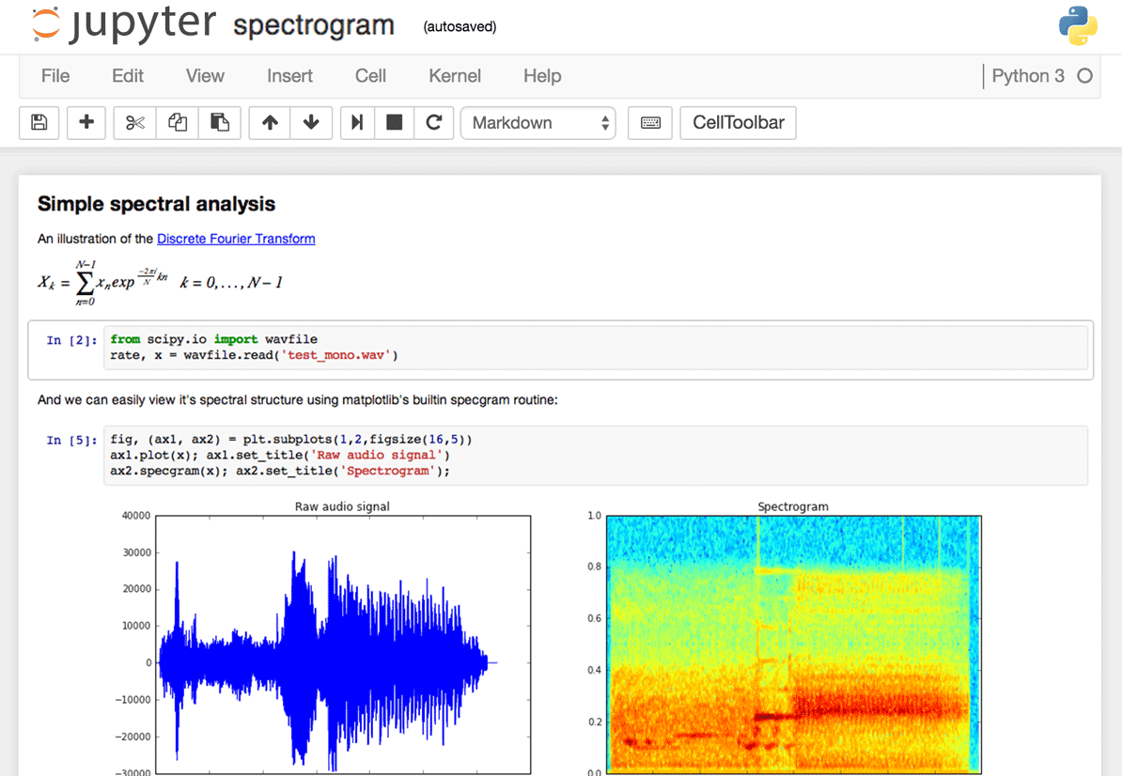
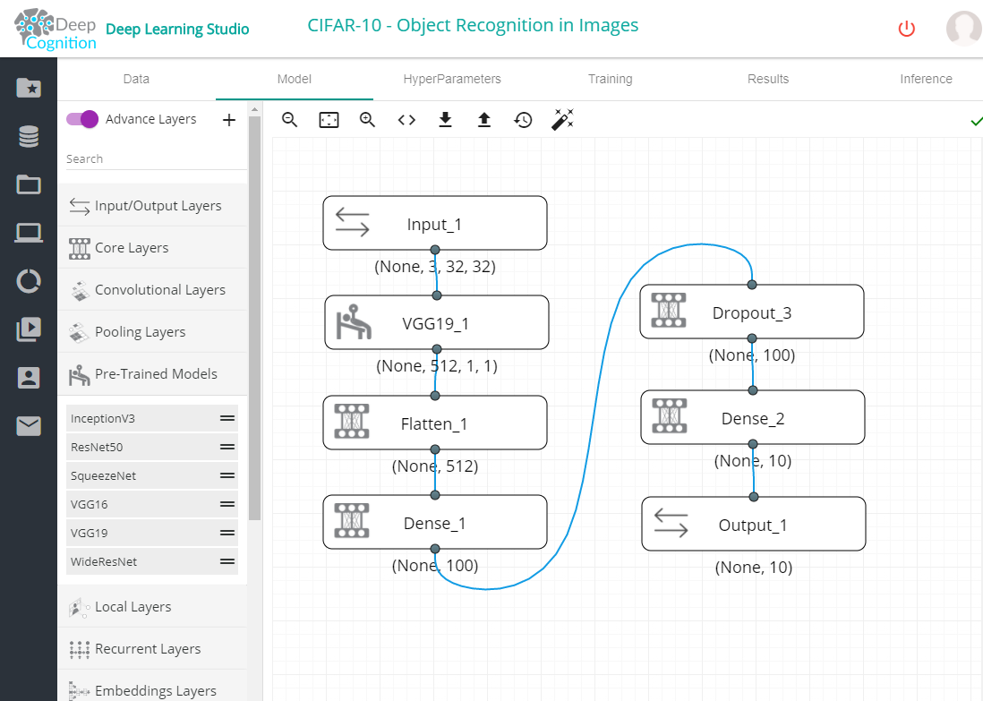
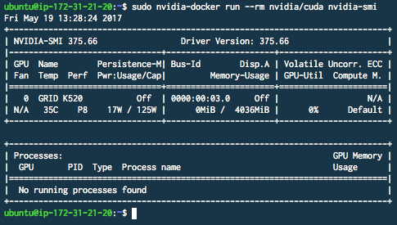
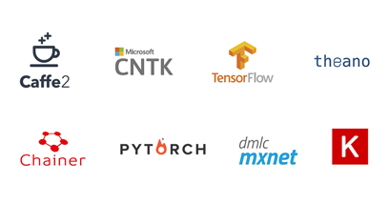
Deep Learning Studio – Features Overview
“Drag and Drop” AI IDE
and Jupyter Notebook
Pre-configured and Optimized Container Environment for Different AI Frameworks
Data Ingestion
Model Design
Model Tuning
Model Training
Model Deployment

Slide 25
Challenge: Fashion MNIST using Deep Learning Studio
Fashion-MNIST is a dataset of Zalando's article images—consisting of a training set of 60,000 examples and a test set of 10,000 examples. Each example is a 28x28 grayscale image, associated with a label from 10 classes. Zalando intends Fashion-MNIST to serve as a direct drop-in replacement for the original MNIST dataset for benchmarking machine learning algorithms. It shares the same image size and structure of training and testing splits.
Solve Fashion-MNIST using Deep Learning Studio
Download DLS: https://s3-us-west-2.amazonaws.com/deep-learning-studio-manager/downloads/windows-x64-prod-v2.5.0/deep-learning-studio-manager+Setup+2.5.0.exe
Or Use Cloud version at https://deepcognition.ai/
Other resources: https://deepcognition.ai/app-videos/
https://towardsdatascience.com/a-video-walkthrough-of-deep-cognition-fd0ca59d2f76

Slide 26
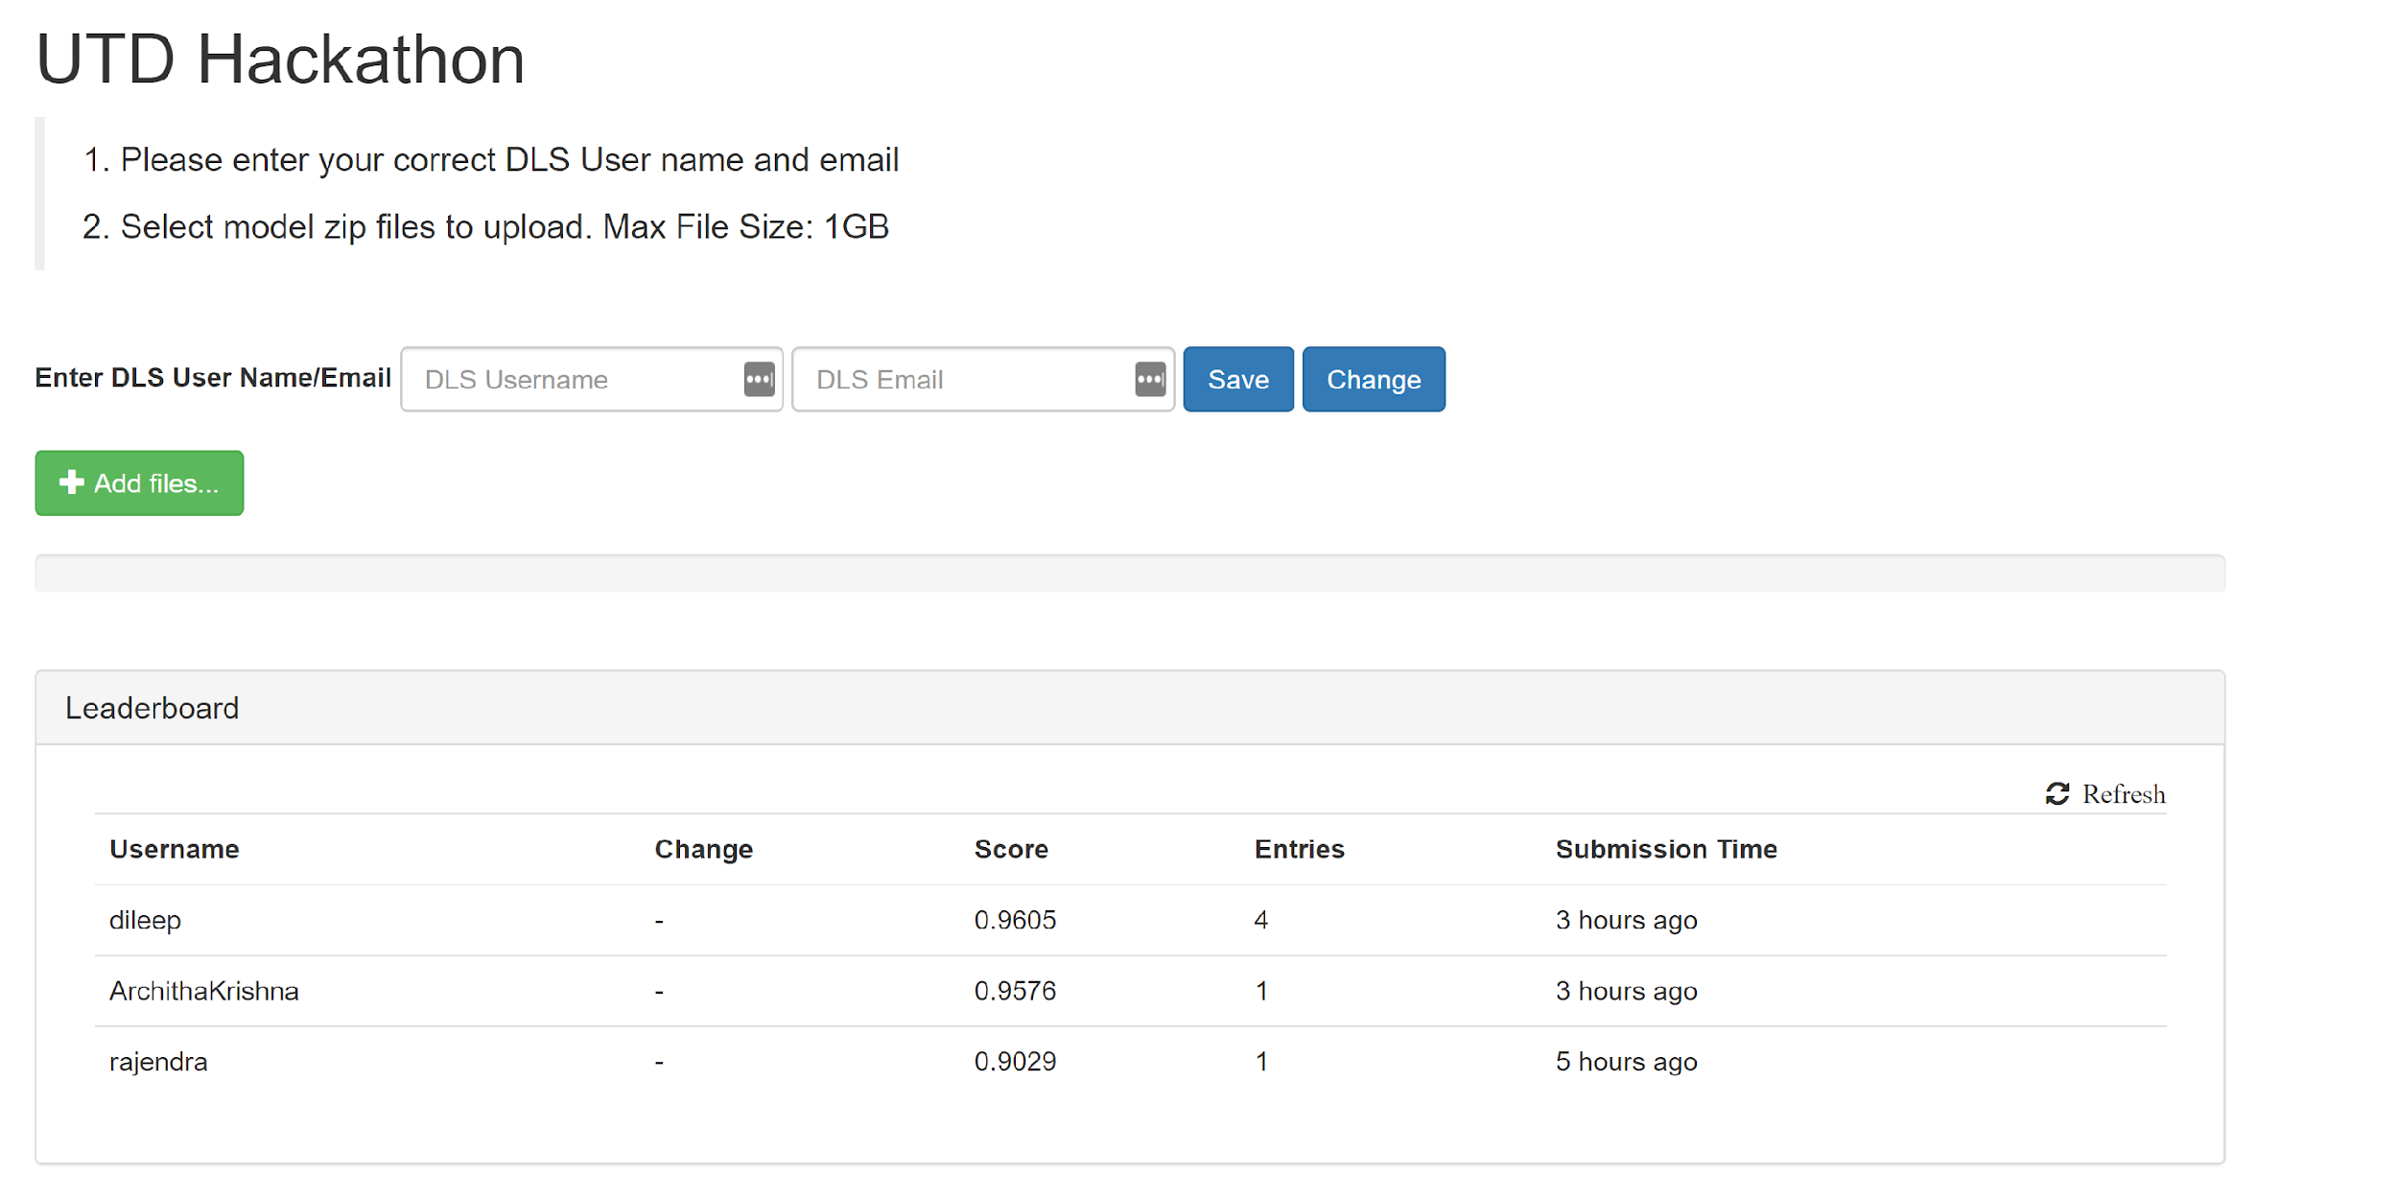
Submission Guidelines
Here are the Submission Guidelines and Submission URL for this Hackathon
http://35.188.160.221/

Slide 27
Evaluation Criteria
Model will be Evaluated based on following
Model Accuracy
Model will be evaluated against hidden dataset which we have slightly augmented to evaluate true accuracy of the model
The Final Score will be published on the link provided in the submission guidelines slides

Slide 28
Hackathon Prize
1st Prize: $250 ( In case of a Tie , the Prize money will get splitted between the participants)
5 Prizes of $50 each for next 5 participants in the order of ranking
Possible Internship Opportunities – There may be a chance to interview for future internship opportunities at Deep Cognition for the participants

Slide 29
Atos Challenge

Slide 30
ATOS
UTD AI Hackathon Presentation

Slide 31

We are leader in Digital Transformation
We are a leader in digital transformation serving a global client base.
In this fast-changing world, driven increasingly by data, Atos brings together people, business and technology to create the firms of the future.
We are the Worldwide Information Technology Partner for the Olympic & Paralympic Games.
Atos is a Societas europaea (SE) company and we are listed on the Euronext Paris market.
We operate under the main brands Atos, Atos Consulting, Atos Worldgrid, Bull, Canopy, Unify and Worldline.
Top 5 digital leader & #1 leader in Europe
€13 billion annual revenue circa
100,000 experts
73 countries
Worldwide IT Partner of the Olympic and Paralympic Games

Slide 32
Atos Digital Transformation Factory Created to Meet Market Disruption Head On
Drive
Design
Deliver
A business-
driven method
Technical blueprints and accelerators
to build our customers data-driven digital platforms
Atos Digital Transformation Factory
Vertical
Solutions
Customer experience
Operational excellence
Business reinvention
Trust & compliance
Manufacturing, Retail, Transportation
Financial Services
Telecom, Media, Utilities
Public, Health
Atos Digital Workplace
Connecting collaborators & customers with data
Atos Codex
Transforming data into business outcomes
Atos Cyber Security
Digital Payments
Atos Business Accelerators
Enabling the real-time enterprise
Atos Canopy Orchestrated Hybrid Cloud
Creating the foundation for digital business

Slide 33









































Further Differentiating Our Portfolio with a Comprehensive Ecosystem of Partners
https://www.intel.com/content/www/us/en/homepage.html
STRATEGIC
CUSTOMERS
RESEARCH &
UNIVERSITIES
STRATEGIC
PARTNERS
CONSULTANTS
CLOUD
PLATFORMS
STARTUPS
AGILE
PLAYERS

Slide 34
Atos Postal Solutions
UTD - Hackathon

Slide 35
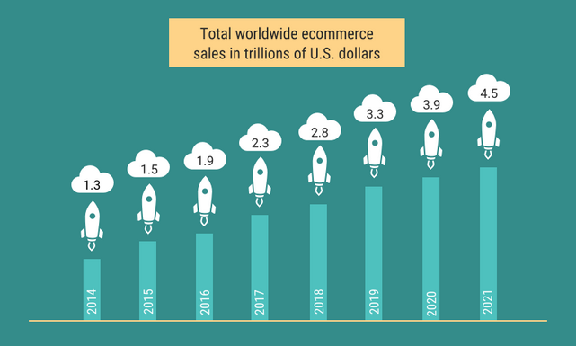
e-Commerce Growth

Slide 36
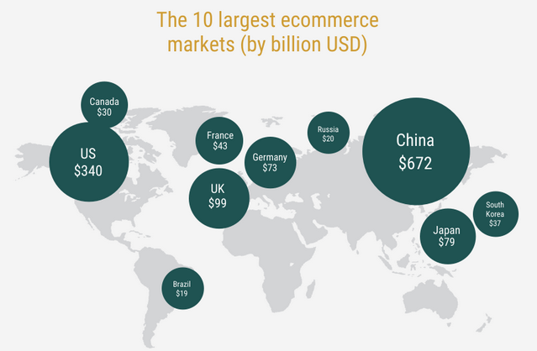
e-Commerce Markets

Slide 37

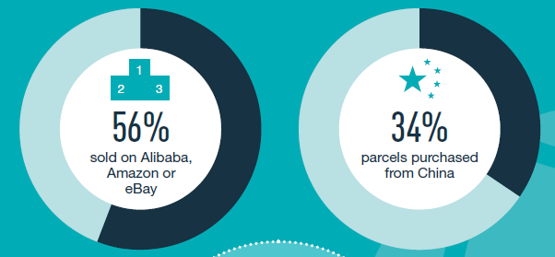
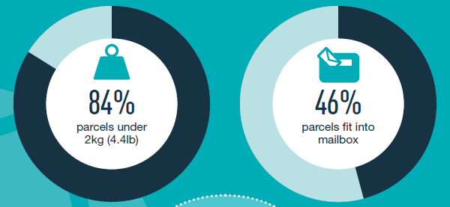
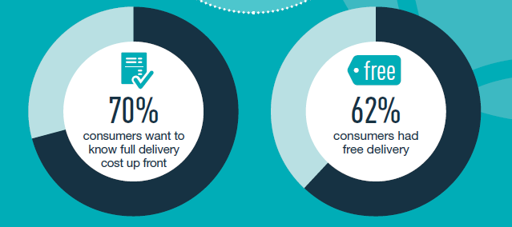
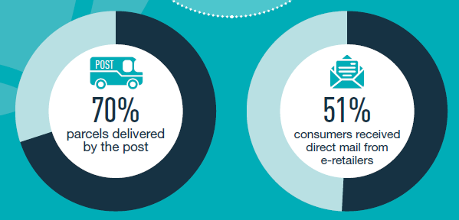
Cross Border e-Commerce Shopper Survey 2017 (by IPC)

Slide 38
Cross Border e-Commerce (National Posts) Electronic Advance Data - Background
In response to a number of external events (including terrorist incidents) in 2008 involving (non-postal) small consignments, calls were made by the UPU to increase the provision of item level Electronic Advance Data (EAD) on international postal items
EAD was conceptualized to prevent explosive devices being carried on airplanes carrying postal articles
EAD has since evolved to facilitate customs clearance procedures and create an extra security layer for risk minimization and prevention.
While full EAD project not yet complete, as EAD implementation increases interim use of EAD possible for limited purposes (i.e. ‘Green Lane’, VAT data reconciliation)
EAD conveys the information on the customs form to destination ahead of the article’s physical carriage

Slide 39

Customs Capture – Video (https://youtu.be/7SIuiB6S7Fg)

Slide 40
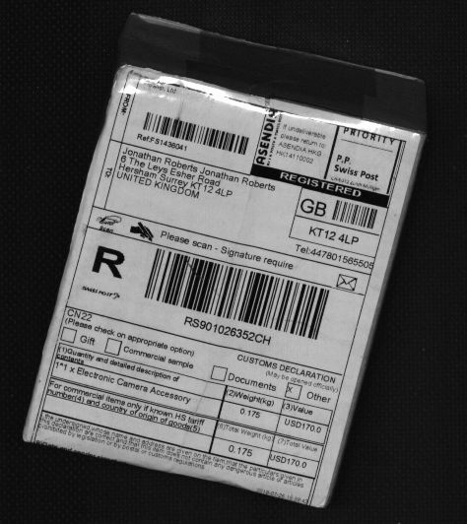
Problem Domain
Packages carry a customs form that detail information about
sender
recipient
contents
weight
value
Problem Domain:
Capturing the above information in real-time while minimizing the human interaction

Slide 41
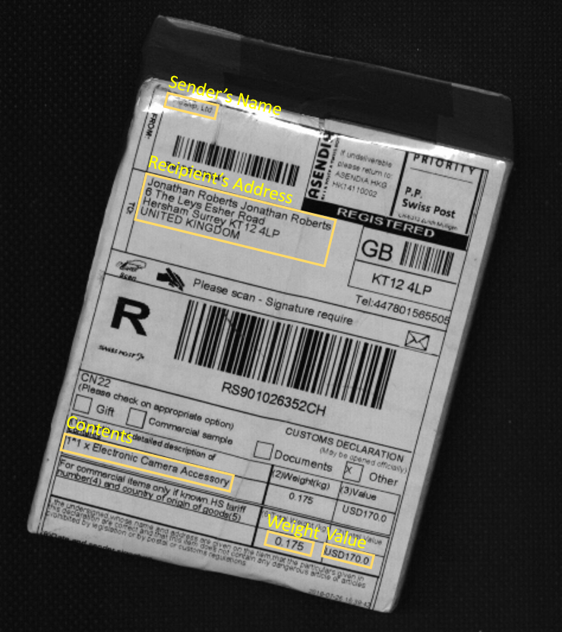
Challenge
Before the information on the form can be read by an OCR, various Regions of Interest (ROIs) must be located and properly classified
The challenge:
Develop Artificial Intelligence (AI)-based tool – specifically computer vision and machine learning could be applied to facilitate locating and classifying ROIs on a customs form
* Reading the contents inside each ROI falls outside the scope of this project

Slide 42
Project Description
Input
Grayscale JPEG images of packages
Output
csv file with the location and type of the various ROIs detected on each image
output the co-ordinates of the bounding boxes for each region
Platform
You may use any platform or library you deem necessary to achieve maximum performance
Google Cloud Platform. Tensor Flow, etc.
Libraries, architectures and code snippets imported either from open source contributions or elsewhere need to be appropriately cited

Slide 43
Additional details
ROI Types
Notes:
A sender or recipient name is often found on the first line of a sender or recipient address block. If that is the case, ROIs of type 0 or 2 will not be separately identified.
In some forms, however, the name is separated into its own field. In those cases, an ROI of type 0 or 2 will be identified.
Not every ROI type can always be identified on an image.
ROI | Type | Comments
Sender’s Name | 0 | If not already part of the Sender’s Address (see note)
Sender’s Address | 1
Recipient’s Name | 2 | If not already part of the Recipient’s Address (see note)
Recipient’s Address | 3
Contents Description | 4
Total Weight | 5
Total Value | 6

Slide 44
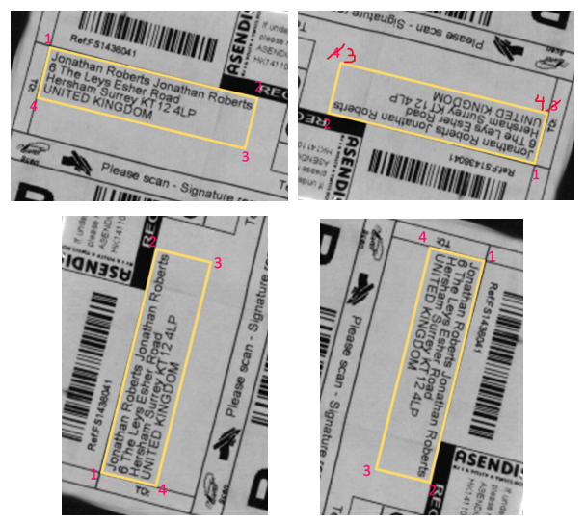
Resources
Training Data
Images containing customs forms various countries (China, USA, UK, Germany, etc.)
~700 images along with a csv file containing correct ROI coordinates
You may break it up into training and validation as you deem appropriate
Python Visualization Software
Resource to help navigate & visualize various ROI coordinates on images
Documents
Full problem description & details
Visualization software installation guide

Slide 45
Testing
Test Data
Blind set of ~300 images
Will be provided at the conclusion of the Hackathon (e.g. 1 hour before the end)
Output
Student results on test data must be provided in the same format as the training set input csv (use visualization software to ensure data accuracy)
Presentation of the solution
full description of the approach
why / benefits
complete set of tools used
detail all open source software
Grading
Results will be graded based on accuracy of bounding boxes yielded by your software
Winners will be notified within 2-3 days

Slide 46
Data Privacy
DO NOT SHARE IMAGE DATA
IMAGE MUST BE RETUREND TO ATOS AT THE END
IMAGES STORED ON LOCAL DISKS MUST BE DESTROYED AT THE END OF THE HACKATHON
Subject to disqualification

Slide 47

IT Challenge edition 2019
@AtosITChallenge
facebook.com\AtosITChallenge

Slide 48
What is the IT Challenge all about?
An international approach For students from all around the world in Austria, Brazil, China, France, Germany, India, Netherlands, Russia, South Korea, Spain, Turkey, UK, US…
A supportive proximity between the Atos teams & Students To help the students in developing their ideas
An amazing reward program
1st : 10,000€
2nd : 5,000 €
3rd : 3,000 €
+ Invitation to the Awards Ceremony in Paris
+ Work experience and opportunities within the Atos Group
A challenging contest
Challenging not only students innovation qualities but also development and business, offering an unique learning experience

Slide 49
The theme: Machine Learning for Sustainability
Machine Learning is a field of Artificial Intelligence that uses statistical techniques to give computers the ability to “learn”.
It is a game changing technology, already being applied in many areas including Video & Serious Gaming, Medical Diagnosis, Fraud Detection, Driverless Vehicles and Security Surveillance. For all its benefits, some are also saying it could be a huge threat – with calls for regulation to protect humanity against AI running out of control. We believe it is an important area for the Atos IT Challenge to explore.
We are seeking how Machine Learning can be applied to the topic Sustainability, in which the exploitation of resources, the direction of investments and the orientation of technological development are all in harmony.

Slide 50

The theme: Machine Learning for Sustainability
Devise an innovative use case and build a prototype, leveraging Machine Learning, to address a sustainability topic. Show how this can provide benefit to the world, and how you could further develop your solution and take it to market.
You may wish to use Google’s Machine Learning and Tensor Flow framework, or other Machine Learning services from the likes of Microsoft or Amazon.
We are looking for interesting applications that could have immediate and impactful real world applicability.

Slide 51
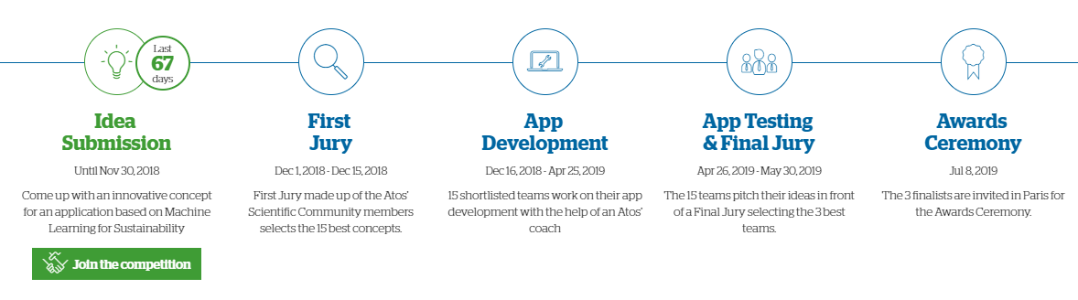
The challenge is split into main 5 phases

Slide 52
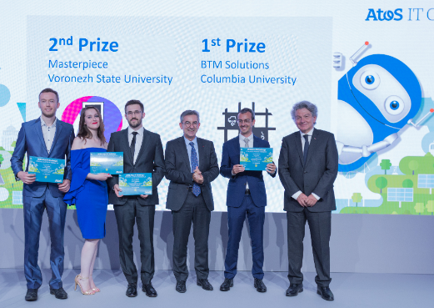
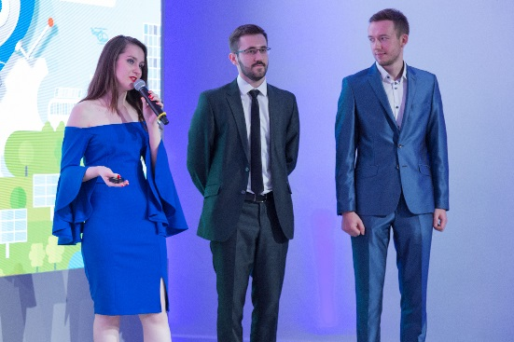
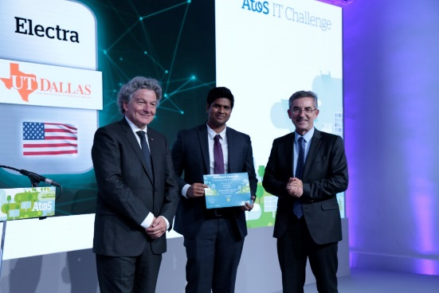
2018 finalists
The Grand winner
BTM Solutions
From Colombia University (USA)
2nd Prize
Masterpiece
From Voronezh University (Russia)
3rd Prize
Electra
From the University of Texas in Dallas
With a solution called 'BTM', “Behind The Meter”, two French and Indian students from Columbia University have developed a service presenting how AI and chatbots can be used in automated demand response applications for connected objects, reducing costs and environmental footprint.
‘Masterpiece’, a chatbot created by four Russian students, can hold conversations about art - help find new exhibitions in a city, enable payment via an application and provide all the information needed about a piece of art thanks to photo recognition.
Two students from the University of Texas in Dallas developed a cloud-based chatbot for the utilities industry to reduce customer service operation costs and provide a more personalized customer experience

Slide 53
Your Career Journey Starts with Atos
Internships - Engage your mind, inspire your creativity, and start your career!
Join us for a 3, 6, or 12 month program – onsite at our Irving office.
Cybersecurity
Software Engineering
Project Management
Shared Functions
Computer science degree, cyber security, & networking
IDS/IPS and web/email proxies
JSON, SOAP, REST interface languages, Java, Python
Cloud - working on API and PaaS products
Automation
Python, Java
Research & Development
Information Analysis, SQL
System Engineer
Technical Projects
Excel
PowerPoint
Human Resources – Recruitment, Learning & Development
Sales & Marketing Operations – Data Analysis, Tableau, PowerPoint, Excel
Internships added year-round. To apply, go to: jobs.atos.net/early-careers

Slide 54
Thanks

Slide 55
Rules and Guidelines
You can compete in multiple challenges!
Final submissions are due at 12:30 pm on Sunday.
If you win a challenge you must provide your source code to the company that sponsored that challenge.
Do not open-source solutions that use company data.
If you are unsure, ask the sponsors.
Do not open-source solutions unless if the sponsor is okay with it.

Slide 56
Side Events/Activities

Slide 57
Immosis VR Demos
Immosis is a VR startup founded by Brian Hoang, a UTD student who is also the founder of the AIS!
Brian will be here from 6-10 pm to give some cool VR demos on the first floor atrium of ECSW!

Slide 58

UT Dallas Board Gaming Club
The UT Dallas Board Gaming Club will have some board games set up on the second floor Atrium from 5 - 11 PM today!

Slide 59
Have Fun and Good Luck!

